Slide 1
Application of Machine Learning In Multistage Quality Control In Automotive Industry 15CS303M-MDD BATCH NO.19, CSE 3-J
Batch Number 19
Abhimanyu Wadhwa
(RA1711003020595)
Nikhil Chopra
(RA1711003020591)
Ritwick Bhaduri
(RA1711003020596)
Guided By,
Ms. Vidhyavani
Assistant Professor
Computer Science and Engineering
SRM Institute of Science and Technology

Slide 2
Introduction
The manufacturing process is a very crucial process in the automotive industry. The success of the automobiles produced largely relies on customer satisfaction and how the product is received in the market.
The process of Quality Control is used after the production of components in order to ensure that there are no manufacturing defects.
In some factories, this process is done manually and the rejected components are discarder. This is a tedious and time consuming process.

Slide 3
In order to increase the speed and efficiency of this quality control process, some techniques of the computer science industry must be implemented within these processes.
This will not only ensure better success rate, but also decrease the time consumed in the process of quality control.
Thus, by using some machine learning techniques, the aim of this project is to increase the efficiency of the quality control department of a factory.

Slide 4
Abstract
The recent advances in information technologies and consequently the increased volume of data that has become readily available provide an excellent opportunity for the development of automated defect detection approaches that are capable of extracting the implicit complex relationships in these multivariate data-rich environments.
In this paper, several machine learning classifiers were trained and evaluated on varied metrics to predict dimensional defects in a real automotive multistage assembly line. The line encompasses two automated inspection stages with several human-operated assembly and pre-alignment stages in between.

Slide 5
Objective
One possible barrier to the success of such a predictive solution in the long term is the possibility of drastic changes in the underlying distributions of the dimensional characteristics of cars. This can happen for instance due to a change in the materials, suppliers or the replacement of parts in the stations, our objective is to overcome this limitation.
A possible solution in the occurrence of this case during production would be through online monitoring and/or training of the models using, for instance, an architecture similar to the one showcased in based on the IDARTS framework

Slide 6
Drawbacks of Existing System
To predict deviations at the end of the line regardless of these interventions, indicating that some of these feature interactions are considerably hard to detect.
The correct assessment of the corrective actions that need to be carried out during the assembly operations (i.e. offsetting the jig) can be improved.

Slide 7
Proposed System
A Multi-Agent System (MAS) can be used to implement the CPPS that abstracts the MMP with one agent associated to the framing stage and another to the final one.
While the framing agent can request quality predictions from a server hosting the deployed classifier and alert operators as defects are identified, the other can check for the ground truth associated with the measurements taken at the end of the line.

Slide 8
Advantages of proposed system
The usage of a MAS also enables the system to adapt to other changes in run-time, including for instance the addition or removal of elements from the line during production without requiring additional programming effort or downtime.
This means that for instance handheld smart inspection tools can be added in to provide additional measurements for the stages in between with the system being able to automatically enact a self-organized response and accommodate such devices and new data into the existing solution.

Slide 9
Literature Survey
S.No. | Title | Year | Technology used | Parameters included
1. | Automated Surface Deformations Detection and Marking on Automotive Body Panels | 2010 | Robotic marking of deformations | Experimental platform, Dimensional deformations, Robotic marking.
2. | Machine learning techniques for quality control in high conformance manufacturing environment | 2017 | Machine learning techniques | Manufacturing, regularized logistic regression, classification threshold algorithm, defect detection, feature elimination algorithm, model selection criterion, quality control, unbalanced data

Slide 10
S.No. | Title | Year | Technology used | Parameters included
3. | Machine learning in automotive industry | 2018 | Machine learning techniques | Smartphone-based GPS records, Data driven Machine learning
4. | Fault Diagnosis of Multistage Manufacturing Processes by Using State Space Approach | 2002 | State space approach | Defect detection, feature elimination algorithm, Dimensional deformations
5. | Recent advances and trends in predictive manufacturing systems in big data environment | 2013 | Big Data Analytics | Big Data, Data driven Machine learning, regularized logistic regression

Slide 11
Module Description
Algorithms for Defect Classification-
Gaussian Naive Bayes- The Gaussian Naive Bayes (GNB) method is a supervised learning algorithm based on the Bayes' theorem with the naive assumption of conditional independence between the various pairs of features given the value of the target variable.
K-Nearest Neighbors- K-Nearest Neighbors (KNN) is a type of instance-based learning algorithm, meaning it does not construct a general internal model, but instead stores instances of the training data with computation being deferred until classification.

Slide 12
3. XGBOOST- XGBoost stands for extreme Gradient Boosting and
is an optimized implementation of gradient boosted trees, designed to be highly efficient and flexible. It is a nonlinear algorithm which typically works well with numerical features and requires relatively less feature engineering and hyperparameter tuning to yield good results.
4. RANDOM FOREST-In the context of classification problems, RF is an ensemble learning method that operates by constructing several decision trees at training time and outputting the class that is the mode of the classes of the individual trees. While a single decision tree can easily run into overfitting problems, being also sensitive to small variations in the data, due to their nature RFs are more robust to such challenges.

Slide 13
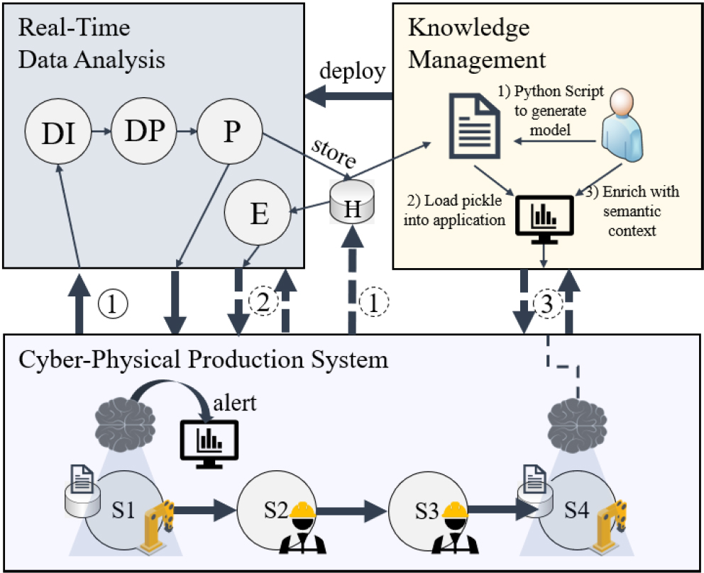
System Architecture

Slide 14
Implementation
This data set consists of three types of entities:
(a) the specification of an auto in terms of various characteristics,
(b) its assigned insurance risk rating,
(c) its normalized losses in use as compared to other cars. The second rating corresponds to the degree to which the auto is more risky than its price indicates. Cars are initially assigned a risk factor symbol associated with its price. Then, if it is more risky (or less), this symbol is adjusted by moving it up (or down) the scale. Actuarians call this process "symboling". A value of +3 indicates that the auto is risky, -3 that it is probably pretty safe.

Slide 15
Perform visualization using at least 5 difference visualization technique:
Barplot
scatter plot
area
boxplot
pie chart
line chart etc.
Which will help to analyze all the problems and gives the answer to different questions faced during Manufacturing Process.

Slide 16
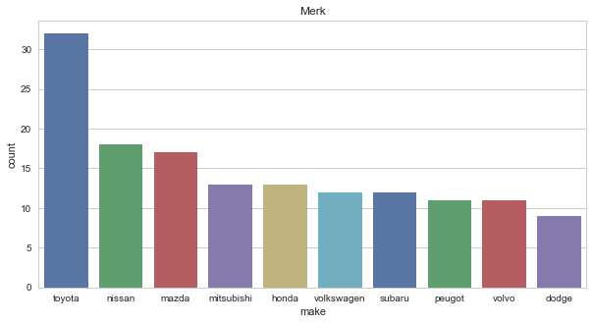
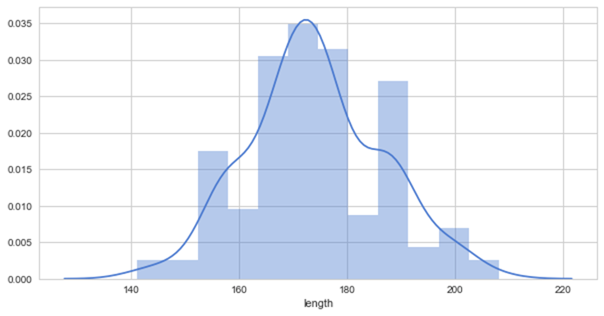
Visualization
Count Plot
Dist Plot

Slide 17
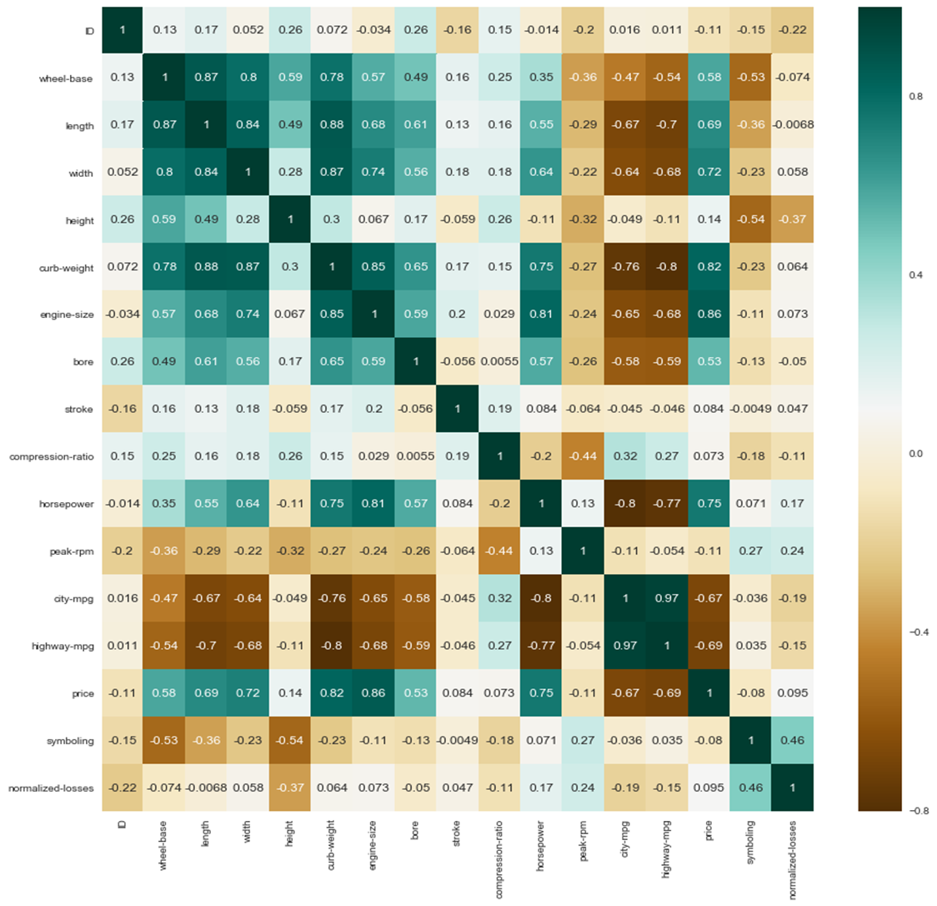
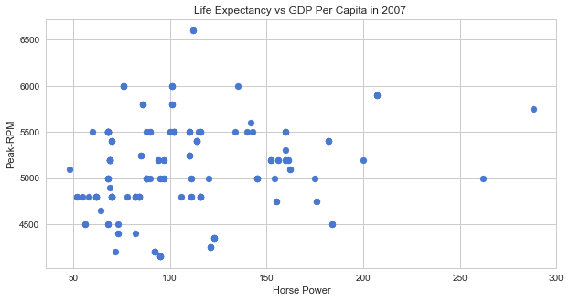
Scatter Plot
Heat Map

Slide 18
Conclusion
The present work attempted to use the SD approach to model the real-world multistage assembly line. We developed the data-driven continuous flow model using continuous flow approximation for assembly work transfers. The part movement is treated as fluid flow, buffer stocks are water tanks, the conveyor belt is a water pipe, and manufacturing stations are the valves that control the rates of flow.
Machine states, i.e. breakdown, starved, and blocked, are treated as discrete events that cause variations in the material flow rate. The statistics of throughput rates match closely with those from previous DES implementations and real-world historical results. It is shown that the proposed continuous flow model can capture the instantaneous (dynamic) throughput rate in a faster manner, and also closely match the DES output during the steady-state. The continuous flow model offers flexibility in choosing the initial states and the actual breakdown and repair times

Slide 19
THANK YOU!

